Slide 1

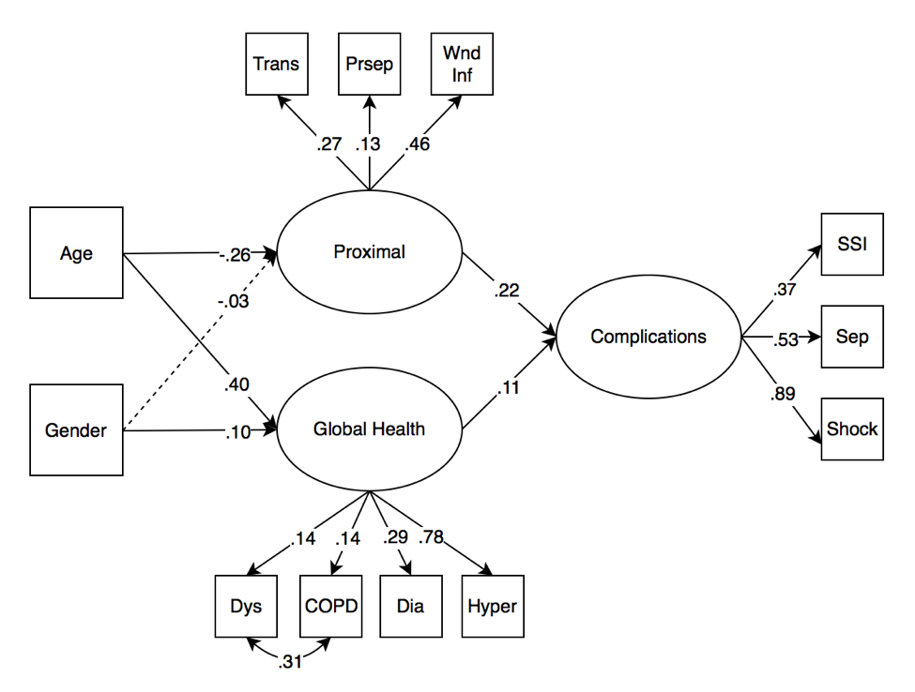
Infectious Complications Following Radical Cystectomy: A Structural Equation Model
S. Scott Shipman, Erin M. Buchanan, Adam C. Reese
Background
Post-operative infections are the most common adverse event following surgery.
Radical cystectomies present greater risk of complications compared to other urological surgeries.
In present literature, structural equation modeling has been absent in predictive models for surgical outcomes
The goal of this study was to examine a proposed model of post-surgical complications for radical cystectomies.
The aim of this model will be to assist physicians concerned about post-operative infections in patients undergoing radical cystectomy.
Results
Factor Analysis generated a latent complications variable (Figure 1).
The model showed significant loadings for all variables excluding gender differences on the proximal factor, and fit indices indicated the model was well fit: RMSEA (.03), SRMR (.03), TLI (.91), CFI (.94).
SEM exhibited two significant pathways to infectious complications (Figure 2).
Figure 1. Exploratory Factor Analysis Loadings to Determine Complications Factor
 | Factor 1 | Factor 2
nsupinfec | 0.05 | 0.06
nwndinfd | 0.02 | 0.12
norgspcssi | 0.00 | 0.39
ndehis | 0.07 | 0.14
noupneumo | 0.31 | 0.09
nreintub | 0.89 | -0.01
npulembol | 0.02 | 0.12
nfailwean | 0.67 | 0.02
nrenainsf | 0.13 | 0.22
noprenafl | 0.30 | 0.09
nurninfec | -0.10 | 0.41
ncnscva | -0.04 | 0.11
ncnscoma | 0.20 | -0.10
ncdarrest | 0.44 | -0.15
ncdmi | 0.15 | 0.04
nothbleed | 0.09 | 0.07
nothdvt | 0.12 | 0.08
nothsysep | -0.03 | 0.83
nothseshock | 0.36 | 0.45
Figure 2. Numerical labels are standardized loadings, and the dashed line indicates a non-significant path.
Methods
Analysis of 2013 data from the ACS NSQIP PUF dataset recipients of radical cystectomies.
1580 subjects met inclusion criteria.
Exploratory Factor Analysis (EFA) and theory based selection was used to identify the complications variable.
Items were removed if they did not load significantly onto their factor or caused Heywood cases.
The SEM model included other factors, such as global health, and proximal pre-operative infectious comorbidities.
Conclusions
The current study identified two important pathways to consider during risk assessment. Two variables emerged as successful predictors of post-surgical infectious complications.
The global health variable was specifically linked specifically to the likelihood of infectious complications. The strongest predictor of infectious outcomes was determined to be the proximal pre-operative infectious commodity variable.
If a patient endorses items on one or more of the pathways, physicians may decide to utilize prophylactic measures for radical cystectomy patients. Additionally, physicians may adopt a more strenuous observation following surgery.

